Slide 1
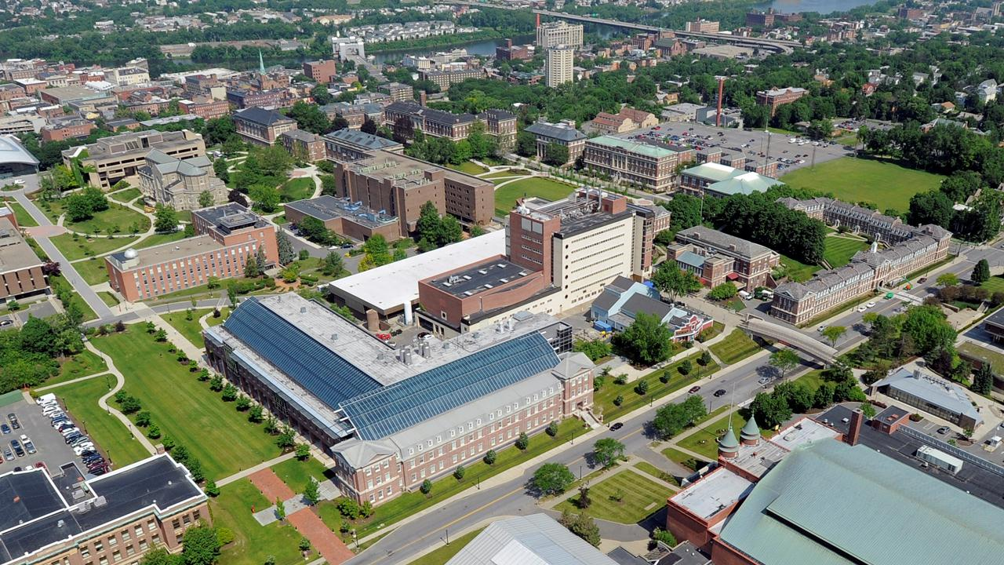


Failures, Dynamics, Evolution and Control of the Global Risk Network
Boleslaw Szymanski
Xin Lin, Xiang Niu, Noemi Derzsy, Alaa Moussawi,
Jianxi Gao, and Gyorgy Korniss
NeST Center & SCNARC
Department of Computer Science
Department of Physics, Applied Physics and Astronomy
Rensselaer Polytechnic Institute, Troy, NY
*email: szymab@rpi.edu
Notes:
Good (afternoon).
In this talk we will discuss Long-term Failure Prediction based on Alternating Renewal Process Model of Global Risk Network.

Slide 2
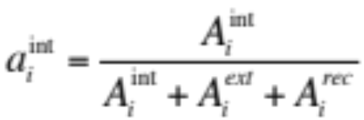

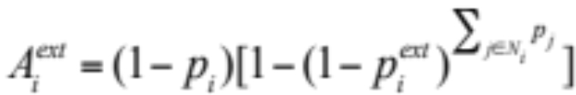
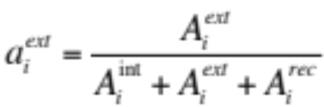
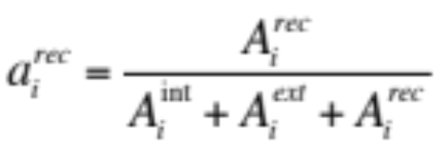

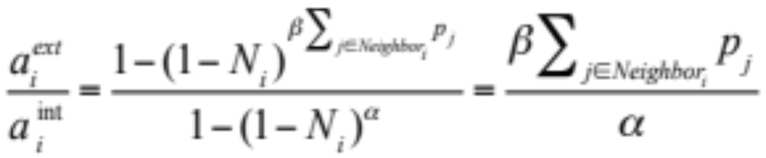
Global Network Evolution: Transition Fraction
  Probability and fraction of transitions
  They depend on the (initial) system state; we assume below the state S∞ which is the steady state at which each risk is active with stable probability p_{i}
  Internal activation:
  External activation:
  Internal recovery:
For small N_{i} from the Taylor’s approximation we get:
2013 network | 2017 network
2.69 | 3.07
Notes:
Internal activation: probability of dormant risk i (1 − pi ) being triggered internally.
External activation: probability of dormant risk i (1−pˆi) being triggered externally.
Internal recovery: probability of active risk i (pˆi) recovering.
The average of probability of external activation by internal activation is around 2.69 for the 2013 network and 3.07 for the 2017 network. Despite β being smaller than α, the network structure amplifies the effects of external activations.

Slide 3
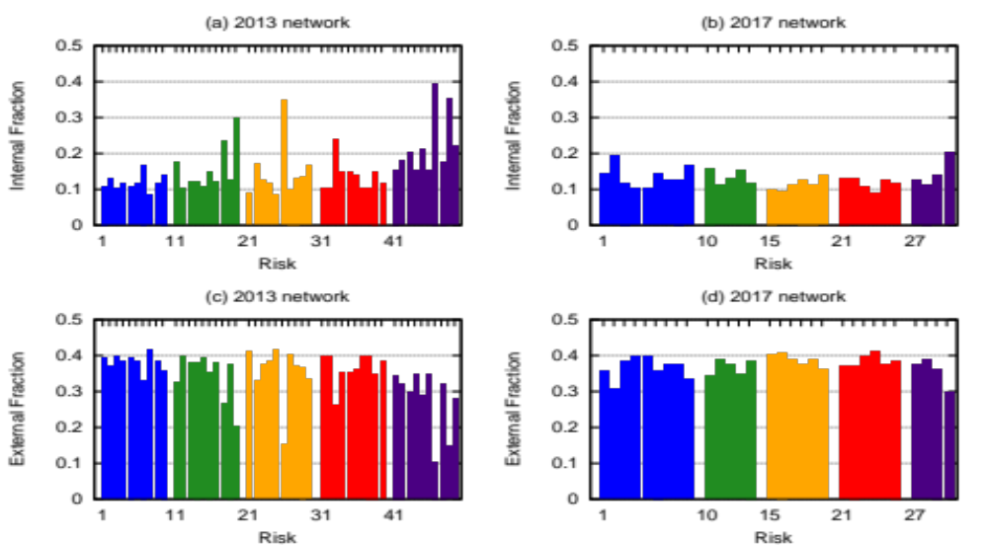
Evolution of Transition Fractions
Notes:
The risks in the 2017 network tend to cluster together and are more likely to be triggered externally in general. A few risks in the 2013 network are almost isolated and are always triggered internally, including 20 “Vulnerability to geomagnetic storms” (6 neighbors), 26 “Militarization of space” (5 neighbors), 47 “Proliferation of orbital debris” (3 neighbors) and 49 “Unforeseen consequences of nanotechnology” (2 neighbors).

Slide 4
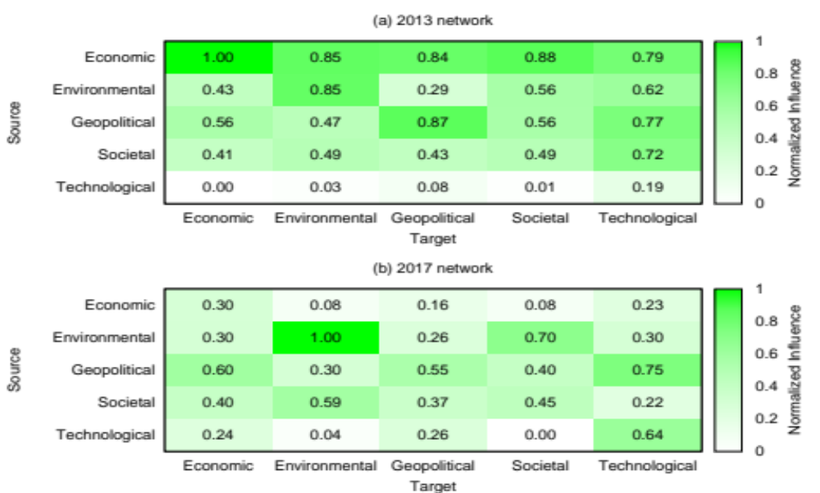
Influence Among Risks
Groups impacting three or more other groups
Notes:
From 2013 to 2017, the most significant changes of risk influences are economic and technological ones. The economic risks used to be the most influential risks and had the highest impact on other risks. However, as of 2017, their influences have decreased. In 2013, technological risks were the most vulnerable risks and had very limited influences on others. Although they are still the least influential risks in 2017, we can see an increasing trend in their influence.

Slide 5
5
Background Information
“A global risk is defined as an occurrence that causes significant negative impact for several countries and industries over a time frame of up to 10 years. A key characteristic of global risks is their potentially systemic nature – they have the potential to affect an entire system, as opposed to individual parts and components. ”
Source: Wikipedia
The spread of cascades could be affected by the topology of an interconnected network.
“A cascading failure is a failure in a system of interconnected parts in which the failure of a part can trigger the failure of successive parts. Such a failure may happen in many types of systems, including power transmission, computer networking, finance, human bodily systems, and bridges.”
Source: Wikipedia

Slide 6
6
Expert Assessments
The report contains also an assessment of the risks potential impact, interconnectivity and likelihood of materialization in the next 10 years prepared by over 1000 business, industry, government, international organization and academic experts.
Likelihood of a risk to occur over the next 10 years:
Each expert defines these likelihoods by numerical value ranging from 1 (lowest likelihood) to 5 (highest likelihood) using integers and mid-points between integers within this range. Average all the experts’ rates and get the final value of likelihood.
Connections between pairs of risks:
Each expert selects at least 3 and up to 10 combinations. There are 515 bidirectional edges defined that way, thus, the average degree of each node is relatively high, 20.6 per node.
Impact:
If one risk were to occur, what is the rate of impact from 1 (lowest likelihood) to 5 (highest likelihood).

Slide 7
7
Cascades due to Single Risk Materializations
Five risks with high contagion potentials were chosen.
The linear nature of the curves on the linear-logarithmic scale indicates that survival probabilities decay exponentially with time.
These long cascade lifetimes, even in the absence of internal failures, demonstrates the profound disadvantage of interconnectivity of global risks.
Interestingly, the lists of top five most persistent risks observed in the cascades and seen in the full dynamics of activation are identical.

Slide 8
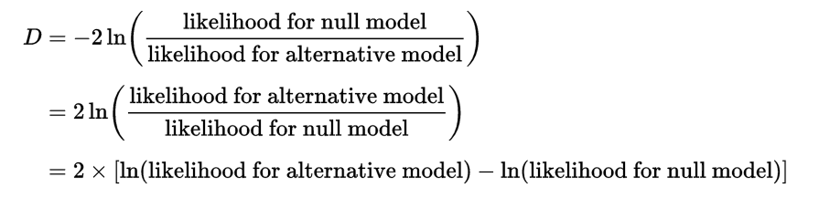
Model Evaluation
8
We use Likelihood Ratio test to evaluate our global risk network (null model) with other alternative models.
Since we know the likelihood of observed historical data of one model, we can compute the likelihood ratio D.
After getting LR and degree of freedom, we can compute the p-value of a significance level and determine which model is a better fit of data.
According to the LR test, the disconnected and expert data based models cannot be distinguished from each other with any reasonable significance level.
The network model outperforms all other models in explaining the observed data with the significance level of 0.01 or lower.

Slide 9
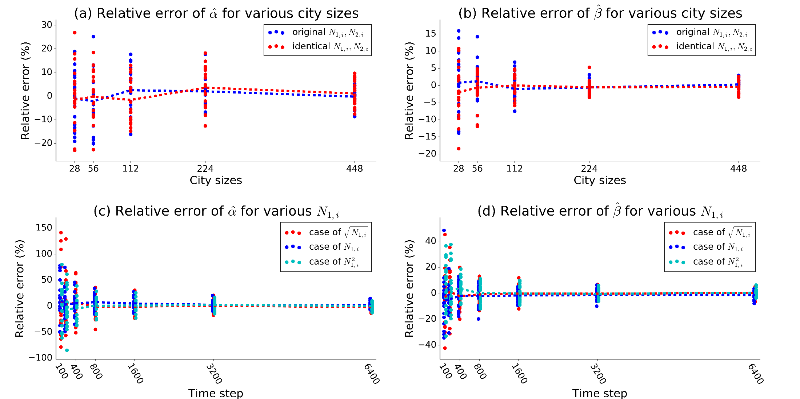
Parameter Recovery in Various Scenarios
In (a)(b), the length of recovery dataset is 1600.
N_{1,i}=0.4 for large, 0.3 for medium and 0.2 for small houses.
There are 20 realizations in each scenario

Slide 10
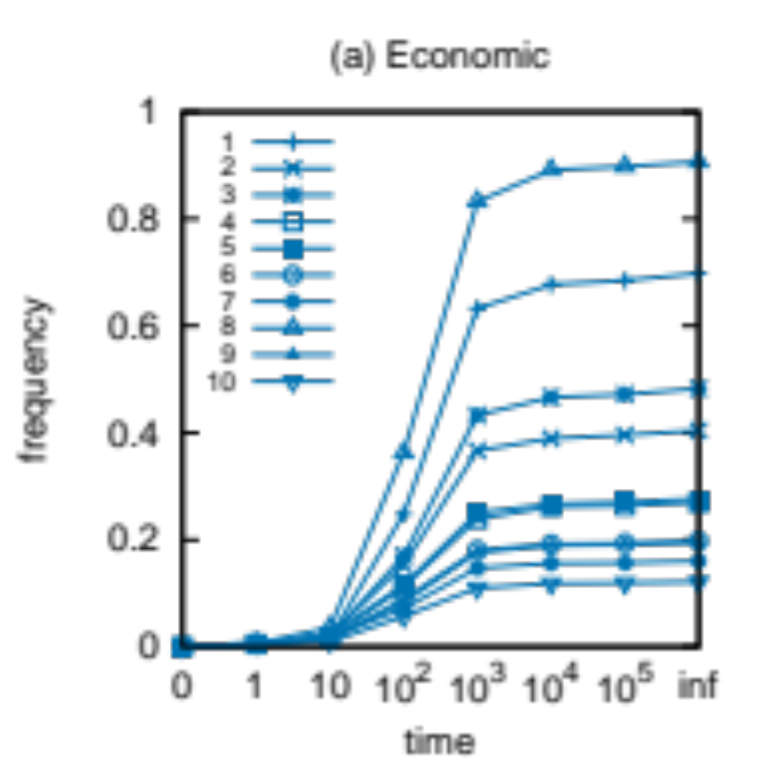
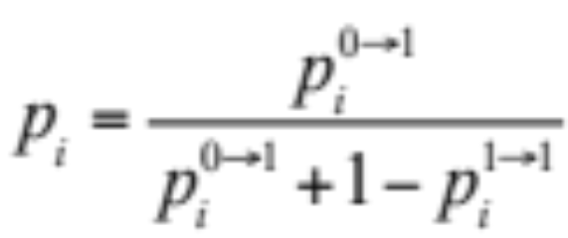
Monte Carlo Simulation (2013 risk network)
10
The global risk network constantly evolves and causes continuous changes in the current state of the global risks and their probabilities.
However, if left unabated, the global risk network would move from the current state to the steady state.
This is why, we compare the steady states to which these current states would move if no changes to the system had been introduced.
At steady state S∞:

Slide 11
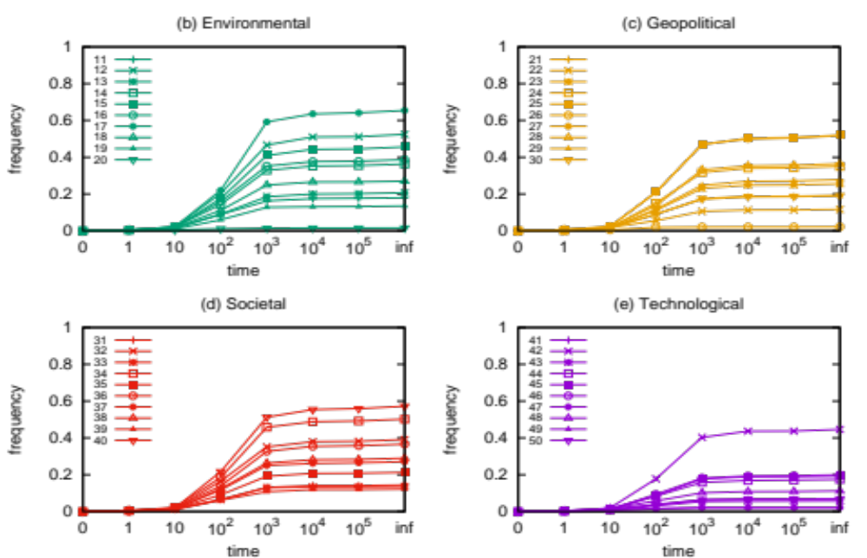
Monte Carlo Simulation (2013 risk network)
11
Notes:
Asymptotic mean-field stable frequencies of selected risks being active are shown for 2013 risk network. Each frequency value is averaged over 1000 runs. For time denoted on x axis as Inf, the frequencies are calculated by above equation.

Slide 12
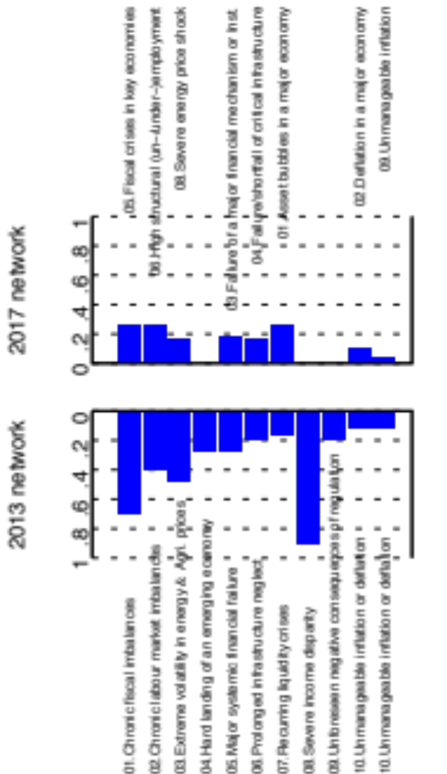
Evolution of Economic Risks
12
Notes:
From 2013 to 2017 five risk categories remain the same, while around 20 risks vanish or merge into other risks. Risk 10, “Unmanageable inflation or deflation” splits into risk 02 “Deflation in a major economy” and 09 “Unmanageable inflation”.
The probabilities of economic risks generally and significantly decrease, reflecting a gradual global recovery from the 2008 economic crisis.

Slide 13
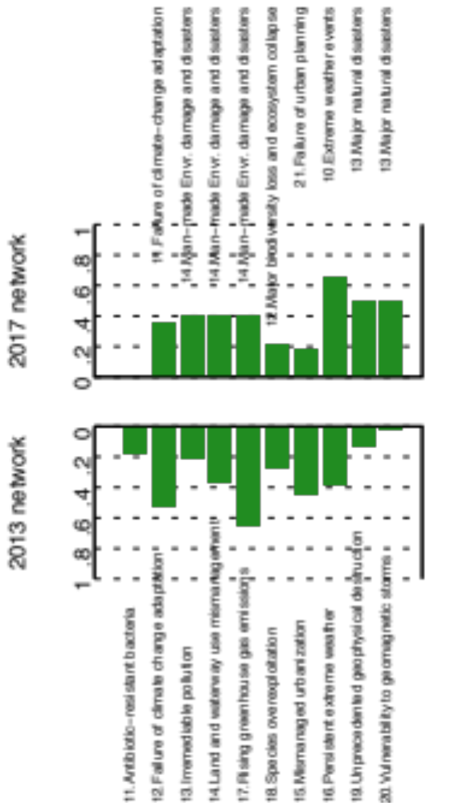
Evolution of Environmental Risks
13
Notes:
Risk 15 “Mismanaged urbanization” changes from Environmental to Geopolitical and is renamed as risk 21 “Failure of urban planning”.
Man made risks decrease, while only nature risks 10 “Extreme weather events” and 13 “Major natural disasters” increase.

Slide 14
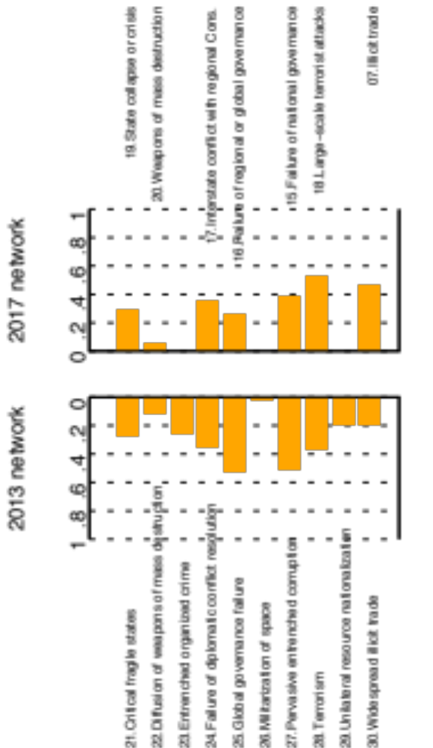
Evolution of Geopolitical Risks
14
Notes:
Risk 30 “Widespread illicit trade” is changed from Geopolitical to Economic and renamed as risk 07 “Illicit trade”, whereas Risk 24 “Profound social instability” is newly proposed.
Only 07 “Illicit trade” and 18 “Large scale terrorist attacks” significantly increase in the category of geopolitical risks.

Slide 15
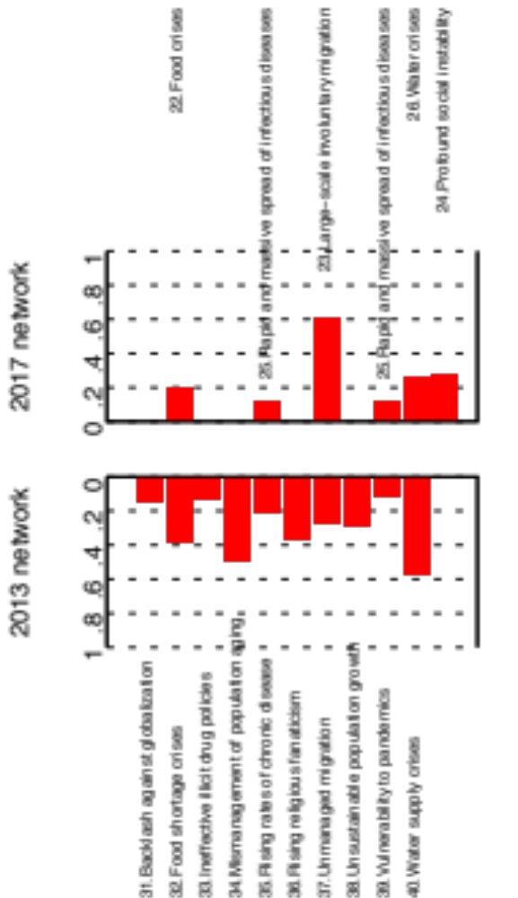
Evolution of Societal Risks
15
Notes:
Only 23 “Large scale involuntary migration” significantly increase in the category of societal risks.

Slide 16
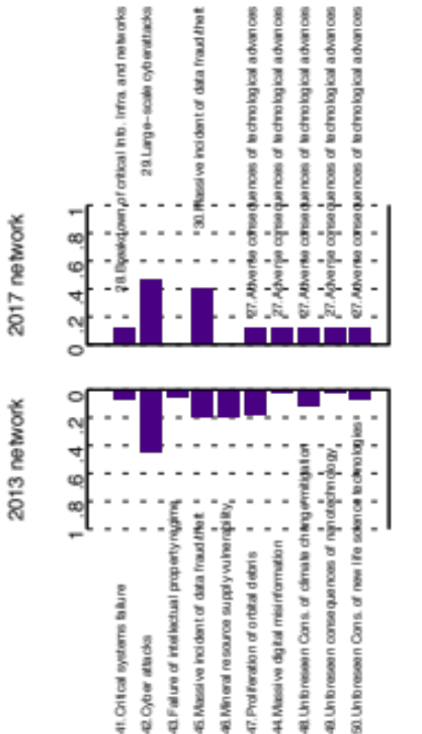
Evolution of Technological Risks
16
Notes:
Risk 30 “Massive incident of data fraud/theft” increases due to the boom of private data in the internet era.

Slide 17
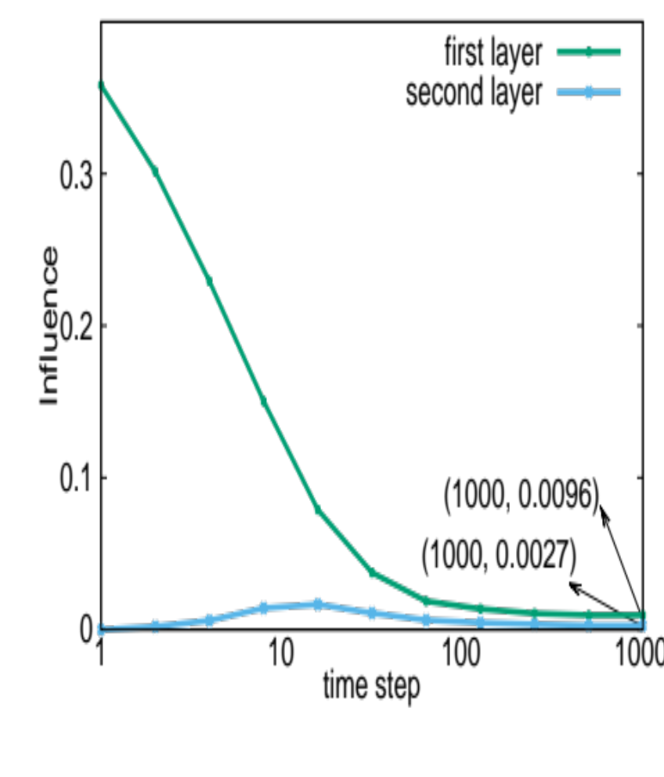


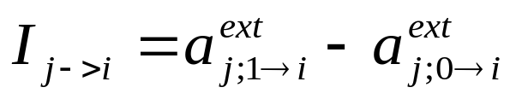
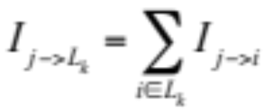
Risk Influence
Two initial states and likelihoods for Monte Caro simulations are needed:
  S_{j;0} in which risk j and all other risks i are initially zero, s_{i}=0, s_{j}=0; risk j is deactivated by setting normalized likelihood value to zero, N_{j}=0
  S_{j;1} in which risk j is initially 1 and all other risks i are zero, s_{i}=0, s_{j}=1.
The fraction of activation with these states are denoted and respectively
Influence of risk j on i:
Influence of risk j on its neighbor layer k L_{k}, where k={1,2}:
The plot below shows the influence of a single risk on their two nearest layers of neighbors in 2017 network averaged over all 30 risks.
Close to steady state S∞
Plotted values are averaged over 1000 runs. Initially large, the difference in influence between the first and second layer decays from large to small ratio near the stable point
Notes:
The influence of risk 01 “Asset bubbles in a major economy” in the 2017 network is most pronounced of economic risks, with the top three influenced risks being economic. The top sixteen influenced risks are simply the nearest neighbors of the source risk. When testing the influence of other risks in both the 2013 and the 2017 networks, we found that for any risk i with n nearest neighbors, its top n influenced risks are always those neighbors. The topology of the network has a prominent effect on the influence. Figure shows an example of the difference of influences of risks on their one-hop (nearest) and two-hops neighbors in 2017 network. One-hop neighbors are immediately affected, but the impact decreases with time; while two- hop neighbors need more time to react, with a peak at approximately 20 time steps.
Figure shows a Monte Carlo simulation of risk influences. For each risk i, we calculate separately the average influence on the risks in its first and second neighborhood layers. We activate the risk i at step 0 and record its influences at every time step. Each influence value in the plot is averaged over 1000 runs and 30 risks.

Slide 18
Global Risks Discovery
We lack an automatic tool to discover risk events.
We want to learn from the Web media which risks were active and when.
We also use the Web media to learn with which risks the public is concerned the most.
Finally, we are interested in regional effects of risks.
Notes:
Our next interesting topic is global risk network analysis. First and foremost, we need high quality data for any in-depth study. However, …. Moreover, …

Slide 19
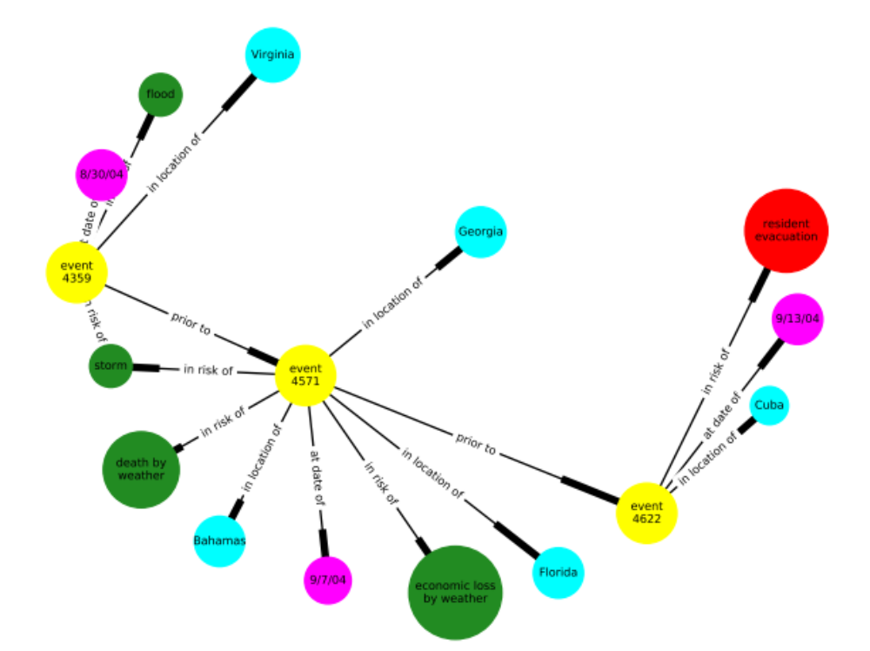
Wikipedia Current Event Portal (WCEP)
We take advantage of the WCEP, one of many knowledge networks created from the Web media content
Notes:
GDELT (https://www.gdeltproject.org) is one large news event websites that are used to analyze threats.
[1] Lu, Xiaoyan, and Boleslaw Szymanski. "Predicting viral news events in online media." 2017 IEEE International Parallel and Distribute
event4359: Tropical Storm Gaston douses Richmond, Virginia, with up to 14 inches of rain, causing widespread flooding. (8/30/04)
event4571: At least nine deaths in Florida, two deaths in the Bahamas, and one death in Georgia are blamed on the storm. Damage estimates range widely from US$2 to US$15 billion. (9/7/04)
event4622: The Cuban government evacuates between 800,000 and 1.3 million people from coastal cities and developed areas. (9/13/04)
d Processing Symposium Workshops (IPDPSW). IEEE, 2017.

Slide 20
Story: 2004 Atlantic hurricane season
event4571: At least nine deaths in Florida, two deaths in the Bahamas, and one death in Georgia are blamed on the storm. Damage estimates range widely from US$2 to US$15 billion. (9/7/04)
event4571:
  in risks of: “storm”, “death by weather”,
  “economic loss by weather”
  in location of: “Florida”, “Bahamas”, “Georgia”
  at date of: 9/7/04
Notes:
Here is an example of how to create an structured knowledge graph by an unstructured event description.

Slide 21
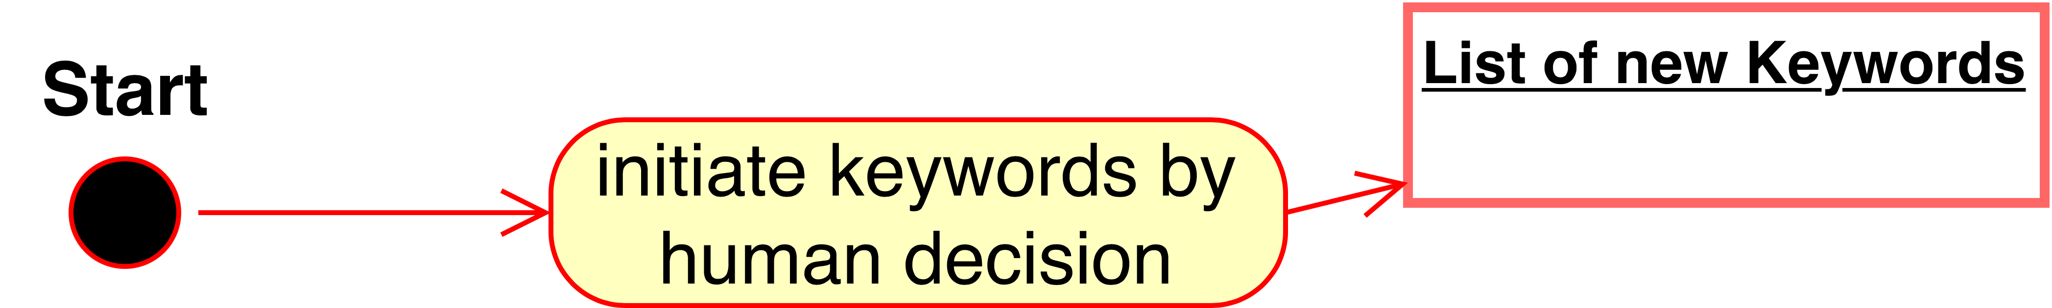
Step1:
Prepares a few keywords and tags for each risk according to the description
Example:
  Risk: “10. Extreme weather event”
  Tag: “storm”
  Keyword: “storm”

Slide 22
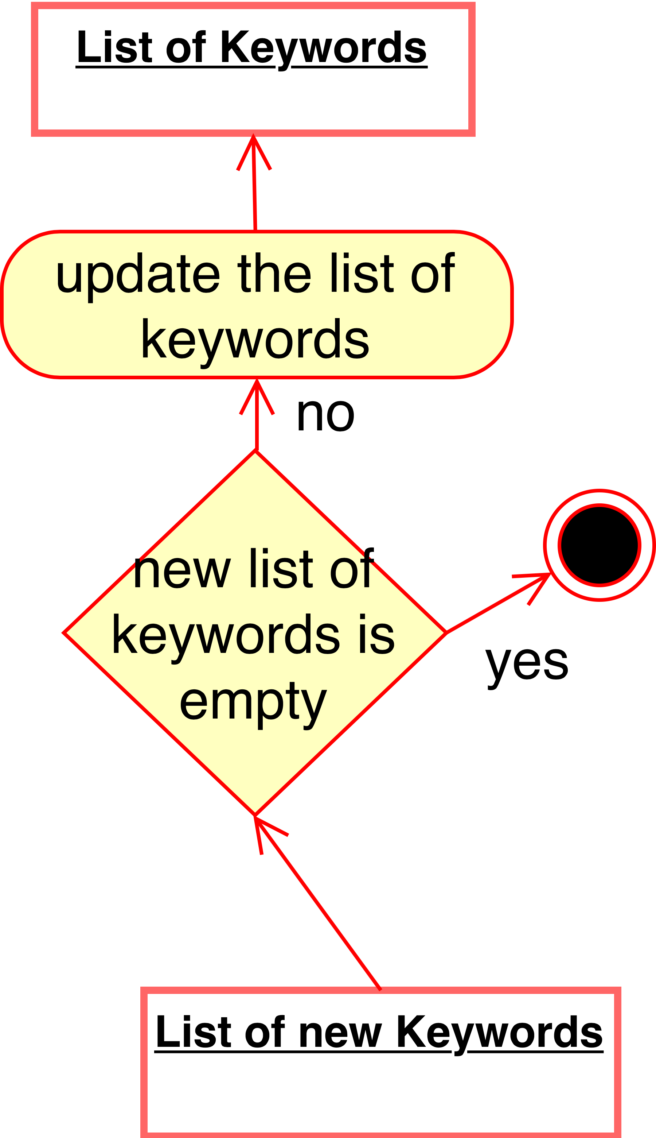
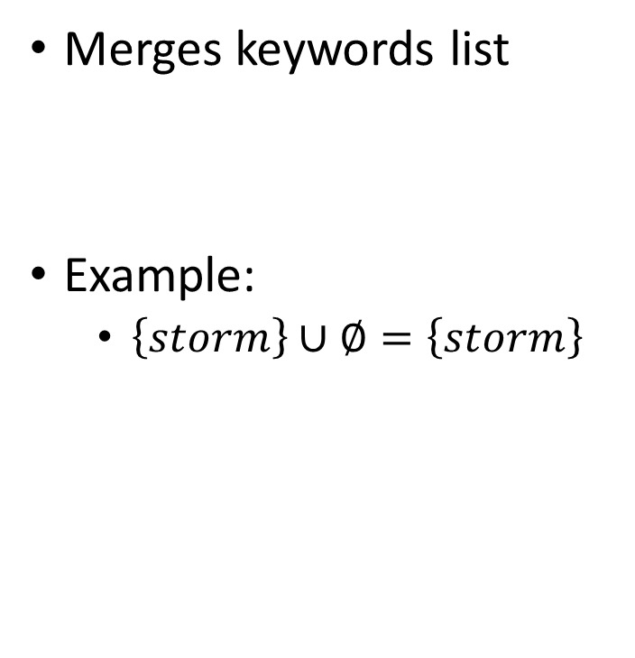
Step 2:
Merges keywords list
Example:
  $\left\{storm\right\}∪∅=\left\{storm\right\}$

Slide 23
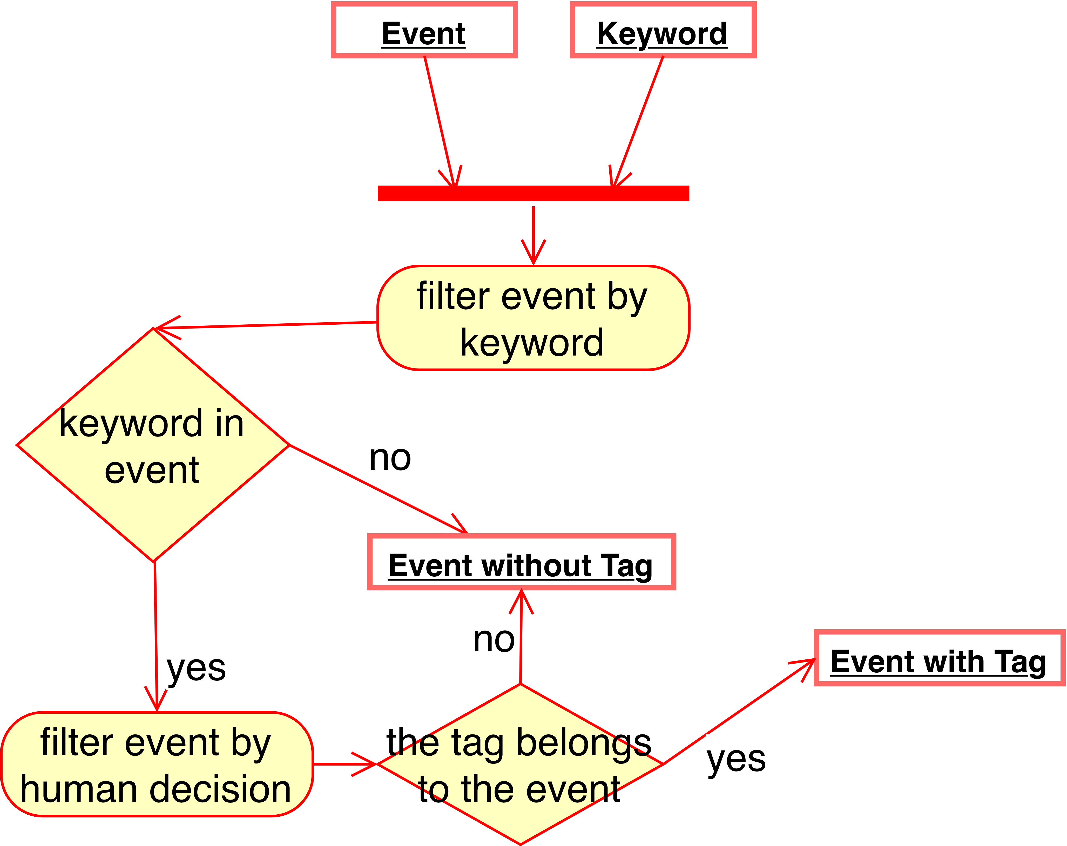
Step 3
Creates for each event a positive or a negative instance.
Example of class “storm”:
  Positive instance:
    Tropical Storm Gaston douses Richmond, Virginia, with up to 14 inches of rain, causing widespread flooding.
  Negative instance:
    Australia's Qantas Airways announces plans to cut 1,500 jobs worldwide

Slide 24
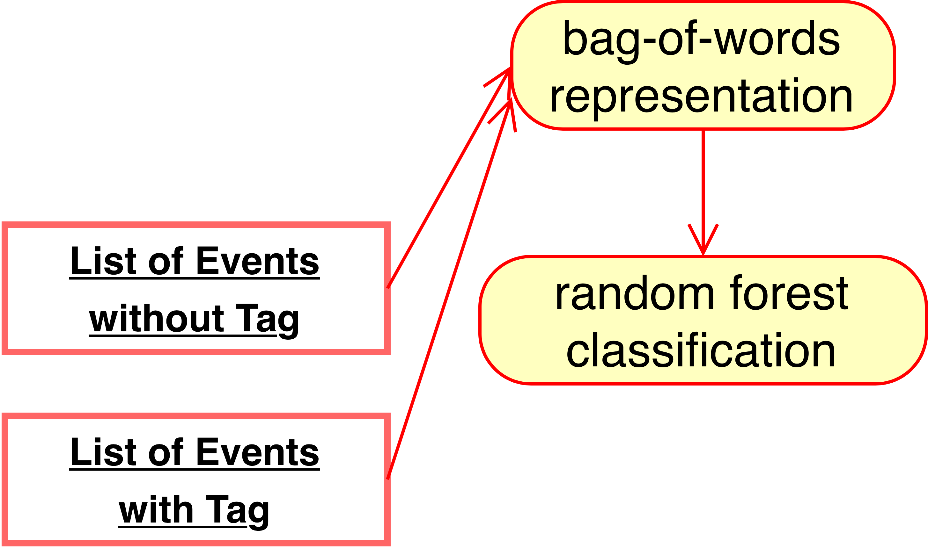
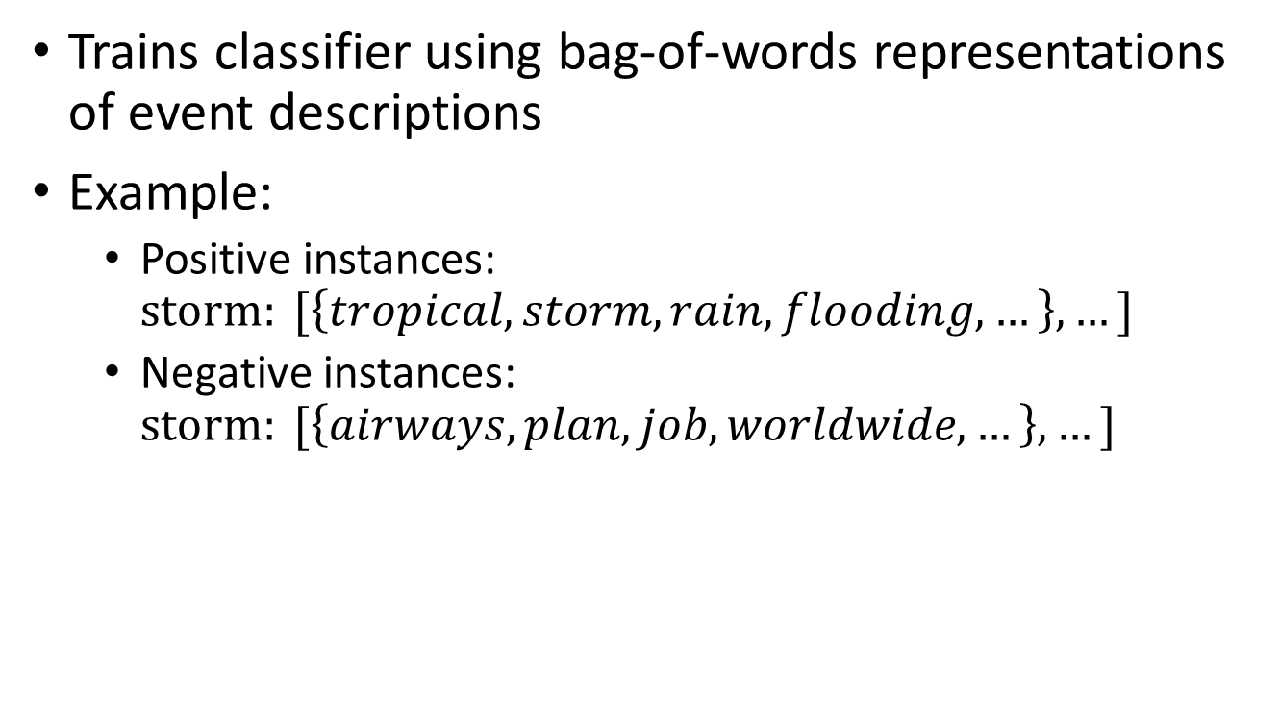
Step 4
Trains classifier using bag-of-words representations of event descriptions
Example:
  Positive instances: $storm: [\left\{tropical, storm, rain, flooding, …\right\}, …]$
  Negative instances: $storm: [\left\{airways, plan, job, worldwide, …\right\},…]$

Slide 25
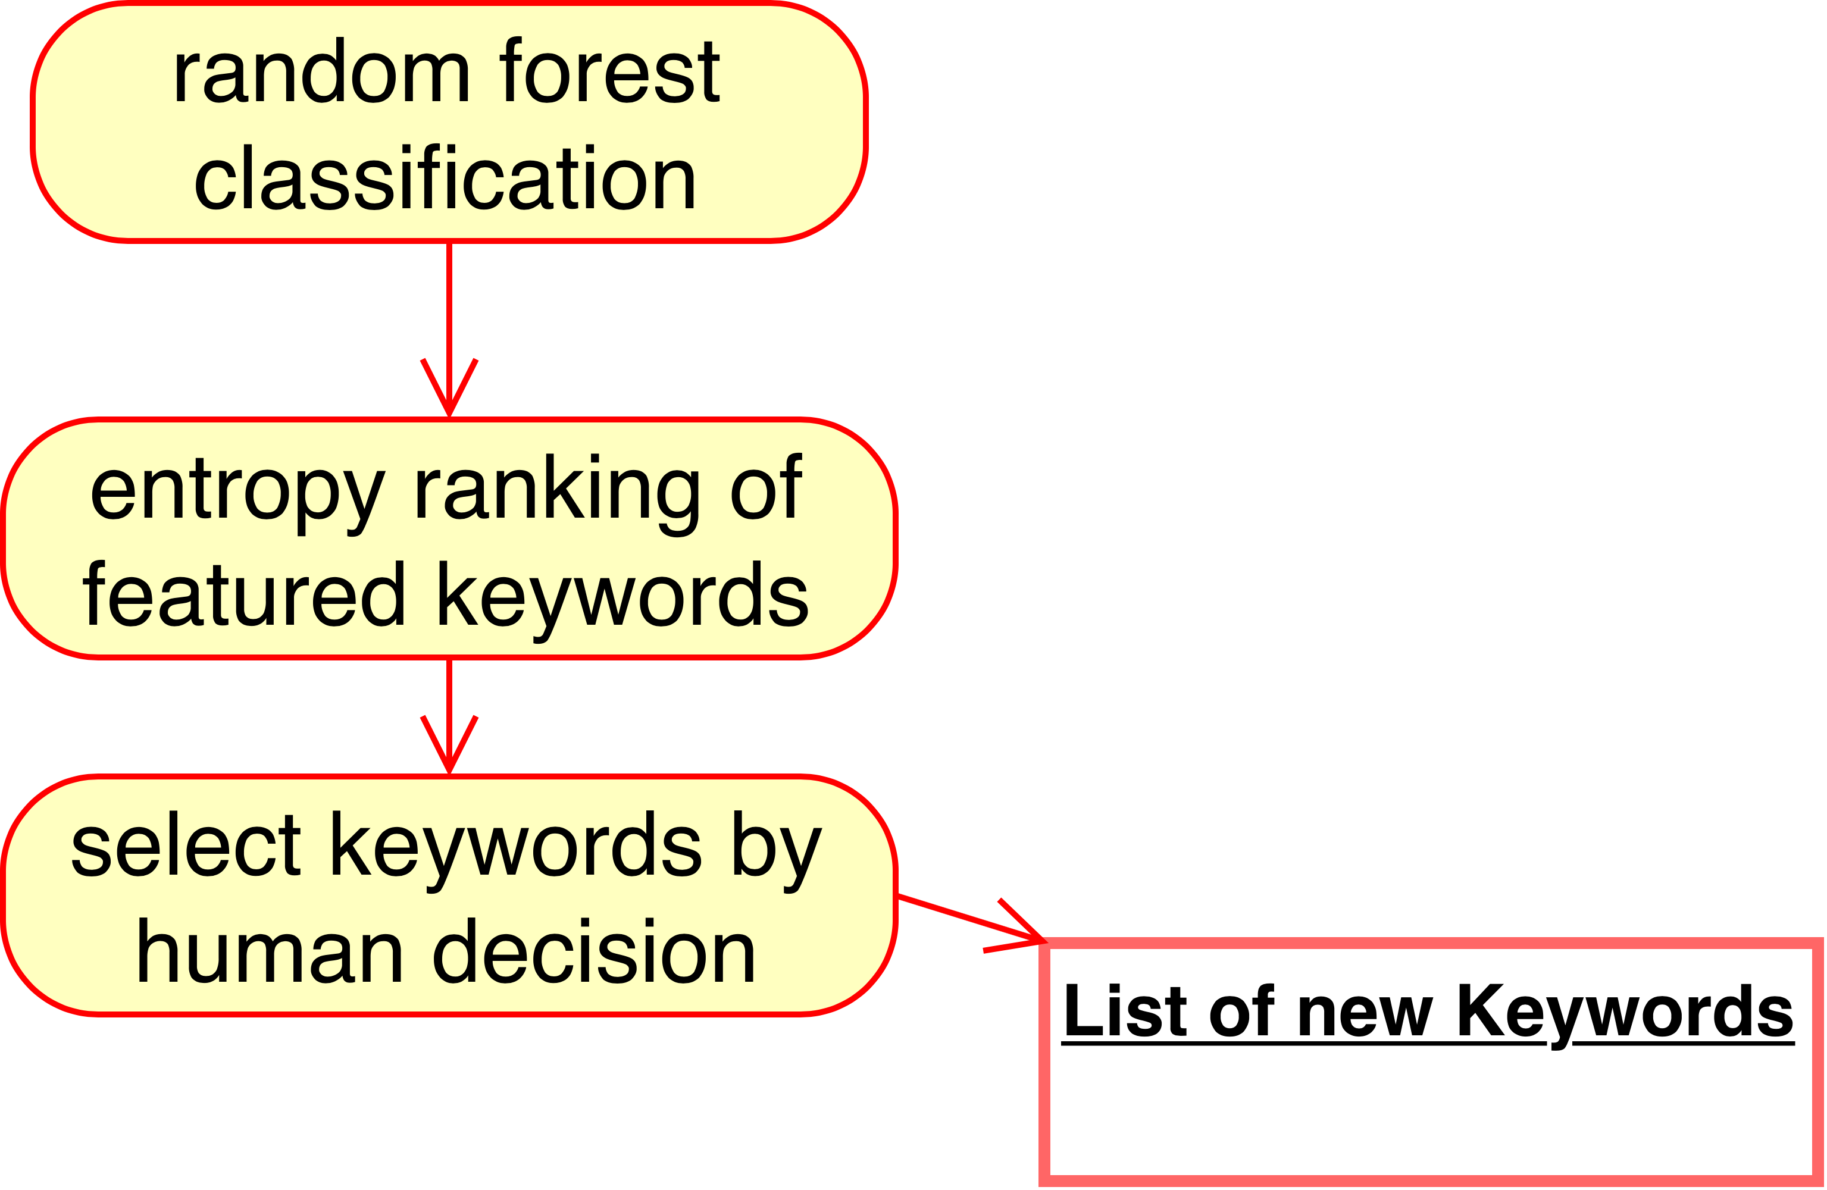
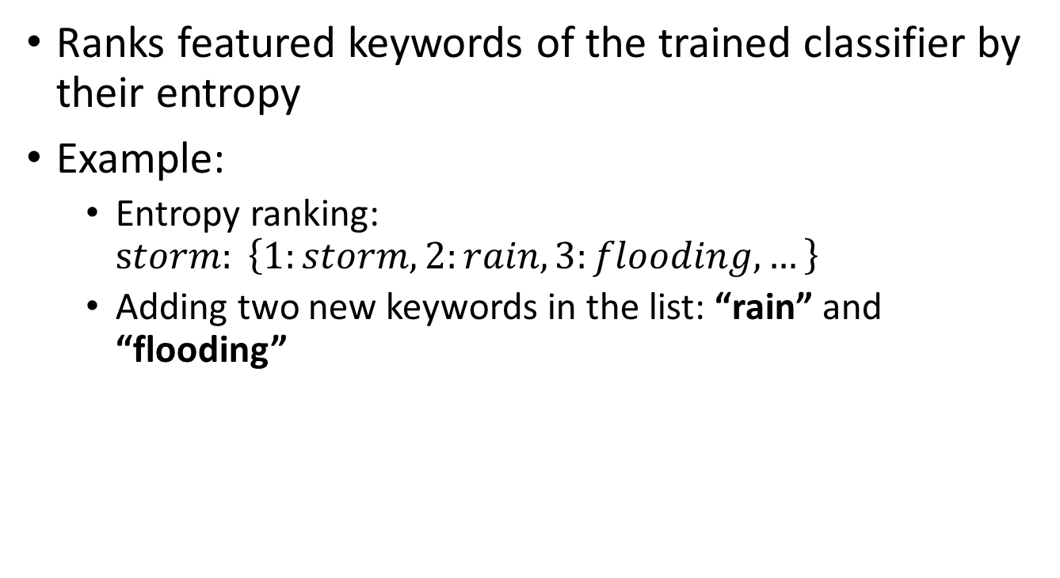
Step 5
Ranks featured keywords of the trained classifier by their entropy
Example:
  Entropy ranking: $storm: \left\{1:storm, 2:rain, 3:flooding, …\right\}$
  Adding two new keywords in the list: “rain” and “flooding”

Slide 26
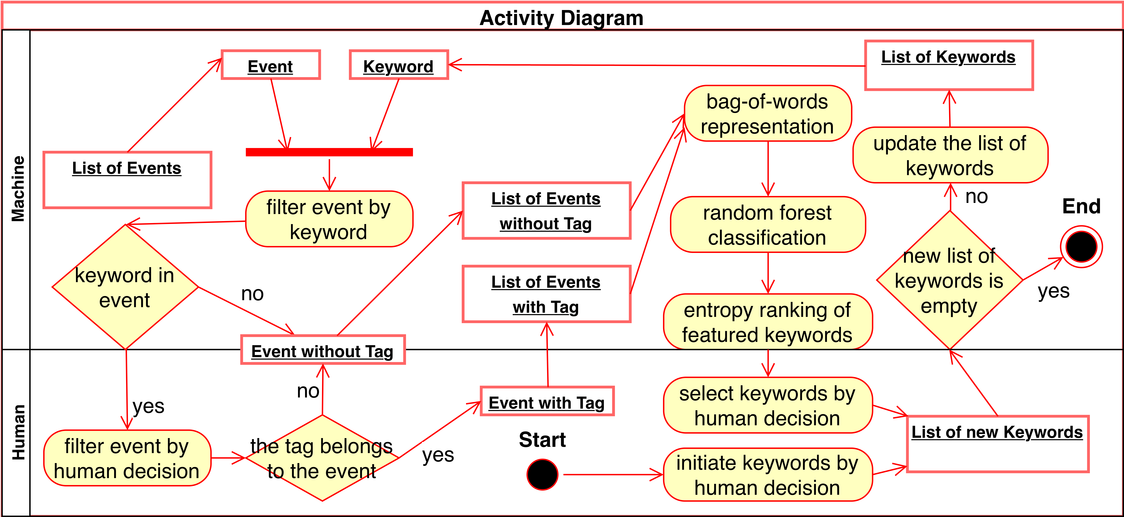
Risk event filtering tool
This process is continued until it eventually achieves all related keywords for the risk events.
Over 90% of events are not related to global risks and do not contain any corresponding keywords.
Notes:
Why it is important? We can use this tool to filter out over 90% nonrelevant events and save a lot of time for manual annotation.

Slide 27
Story: 2004 Atlantic hurricane season
event4571: in risks of “10. Extreme weather event” and “11. Failure of climate-change mitigation and adaptation”
event4622: in risks of: “23. Large- scale involuntary migration”
10
11
23
Notes:
With the structured risk event data set, we are interest in discover risk relationships in Wikipedia

Slide 28
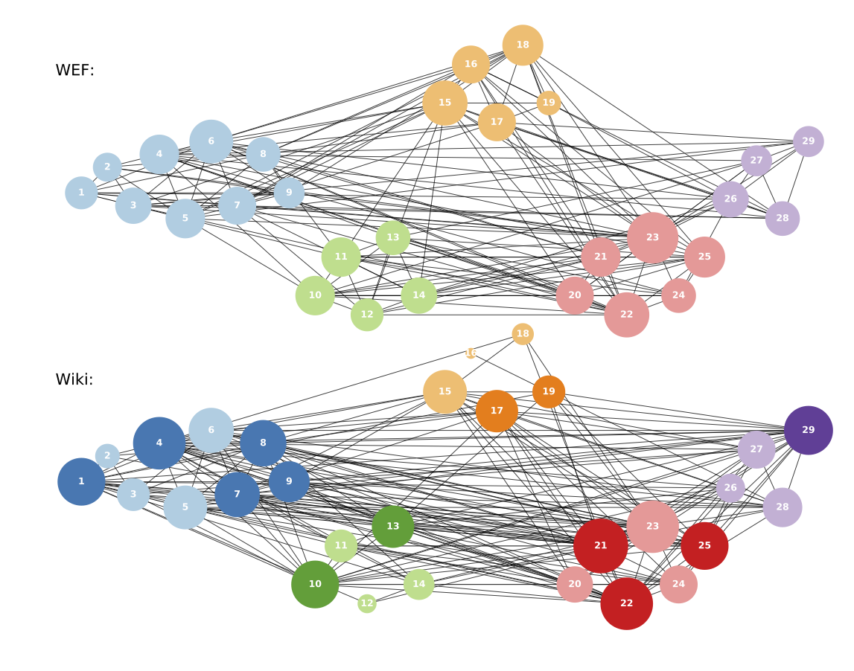
Relational dependencies
Risks with future (potential) impact on humanity
170 edges
108 common edges
Biodiversity loss
Private data leak
Asset bubble
201 edges
Extreme weather event
Risks that directly impact everyday life
Notes:
The experts show concern about yet unseen risks that may arise in the future or have an enormous impact on all humanity, while the public tends to focus on risks that matter to everyday life

Slide 29
Story: 2004 Atlantic hurricane season
event4622:
  - in risk of: “23. Large- scale involuntary migration”
  - in location of: “Cuba”
event4359
  - in risk of: “10. Extreme weather event”
  - in location of: “Virginia”
event4571:
  - in risk of: “10. Extreme weather event” and “11. Failure of climate-change mitigation and adaptation”
  - in location of: “Florida”, and “Georgia”
Risk category | Country | Count
Environmental risk | United States
Risk category | Country | Count
Environmental risk | United States
Societal risk | Cuba | 1
+1
+1 = 2
Notes:
We are also interested in discover regional effects of risks.

Slide 30
Political heat-map (Economic)
Russia (1.00)
U.S. (0.95)
Greece (0.61)
Japan (0.75)
Mexico (0.72)
Notes:
Most of the economic risks happen in the countries with high volume of trading resources, industrial products or services.

Slide 31
Political heat-map (Environmental)
U.S. (1.00)
China (0.97)
Japan (0.91)
Mexico (0.90)
India (0.91)
Notes:
The environmental risks usually happen in coastal countries, especially those near Atlantic (U.S., Mexico), Pacific (China, Japan), or Indian Ocean (India).

Slide 32
Political heat-map (Geopolitical)
North Korea (1.00)
Syria (0.62)
Notes:
The geopolitical risks are in countries having unstable regime or involved in national conflicts

Slide 33
Political heat-map (Societal)
Syria (0.98)
Notes:
Societal risks, are often a consequence of geopolitical risks, and usually occur in the same regions

Slide 34
Political heat-map (Technological)
U.K. (0.51)
U.S. (1.00)
Notes:
Technological risks frequently happen in a scientifically developed country

Slide 35
Contributions:
Built an automatic detection tool for risk events collection
Reconstructed relational dependencies from risk events in the WCEP.
  The experts show concern about yet unseen risks that may arise in the future or have an enormous impact on all humanity
  The public tends to focus on risks that matter to everyday life
Discovered spatial characteristic of risks by analyzing local information extracted from events.
  Economic risks are in trade developed countries
  Environmental risks are in coastal areas
  Geopolitical risks are in unstable nations
  Social risks are the consequence of geopolitical risks
  Technological risks are in technologically advanced countries

Slide 36
Risk network control
We need a solution to control networked risks optimally.
We need to balance costs in different control stages.
We need to study the specific characteristics of risk network control:
  The intermediate state costs in the risk network are non-negligible.
  The desired final state is not the same as the steady state, which needs continuous control input to keep the system at the final state.
Notes:
With high quality structured event data and discovery of tempo-spatial characteristics of events. Our next question is to control the risks efficiently.

Slide 37
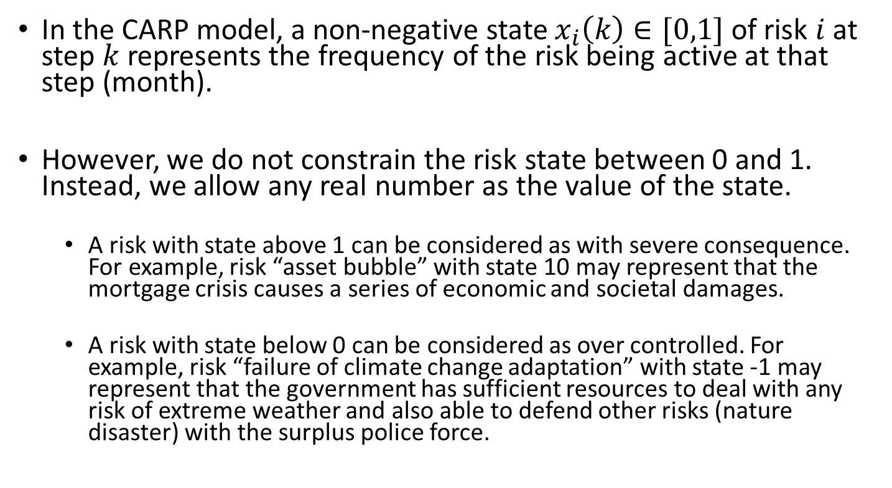
Assumptions and limitations
In the CARP model, a non-negative state $x_{i}\left(k\right)∈[0,1]$ of risk $i$at step $k$ represents the frequency of the risk being active at that step (month).
However, we do not constrain the risk state between 0 and 1. Instead, we allow any real number as the value of the state.
  A risk with state above 1 can be considered as with severe consequence. For example, risk “asset bubble” with state 10 may represent that the mortgage crisis causes a series of economic and societal damages.
  A risk with state below 0 can be considered as over controlled. For example, risk “failure of climate change adaptation” with state -1 may represent that the government has sufficient resources to deal with any risk of extreme weather and also able to defend other risks (nature disaster) with the surplus police force.

Slide 38
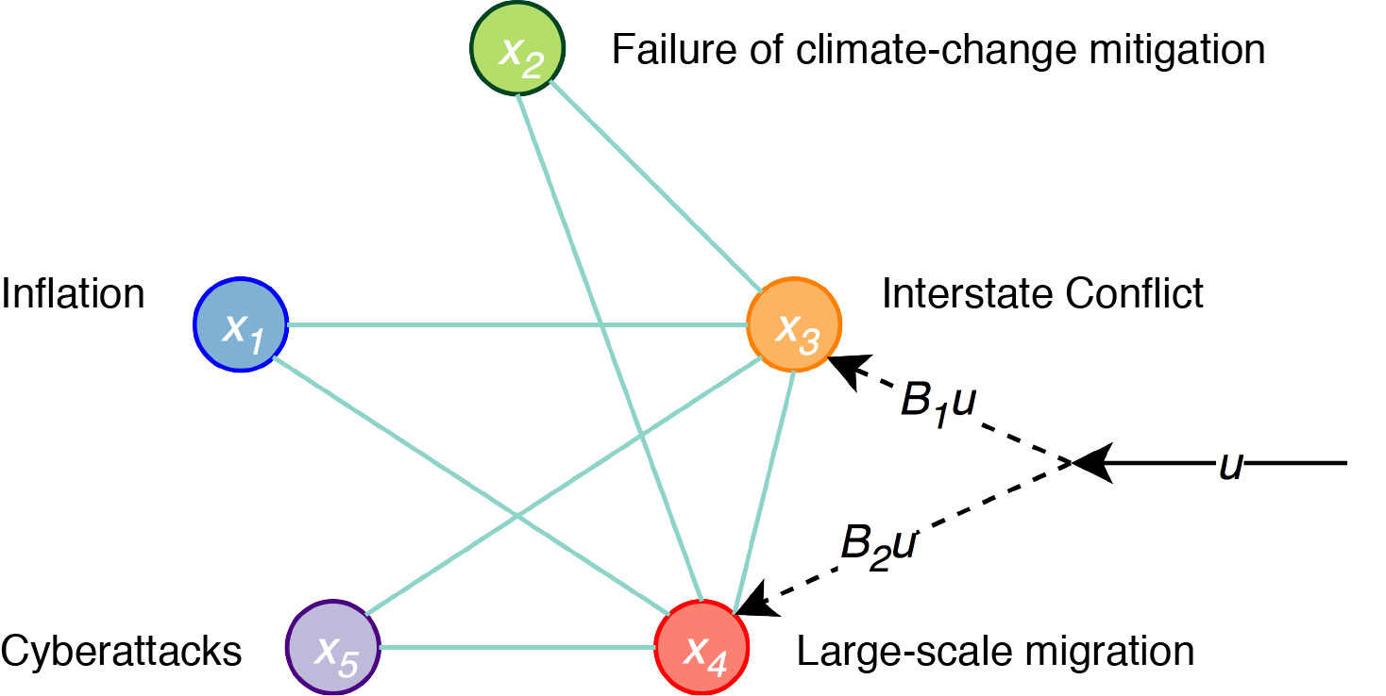
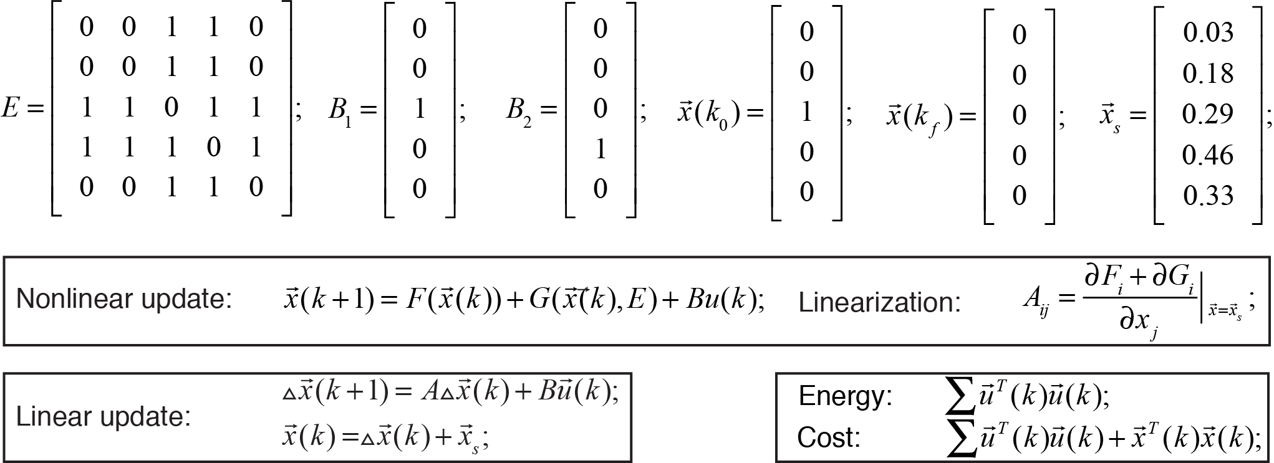
Risk control example

Slide 39
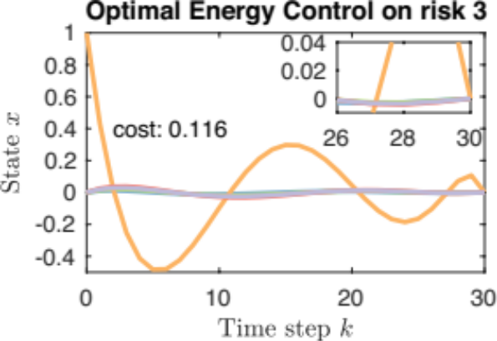
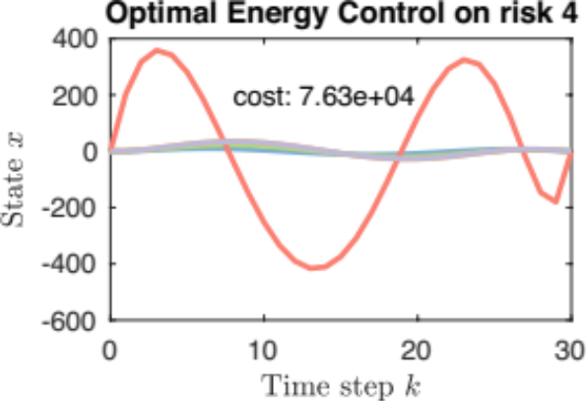
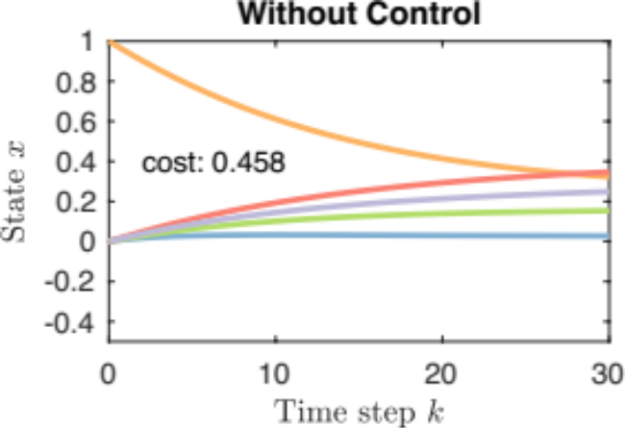
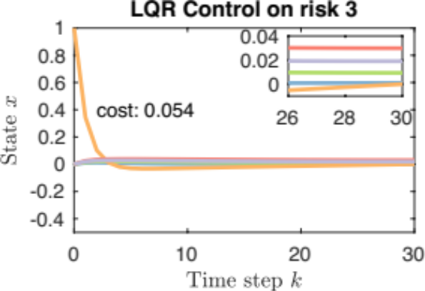
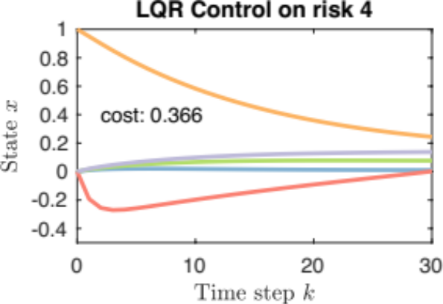
Reactive control example
Control active risk 3 costs less than control a nonactive risk 4

Slide 40

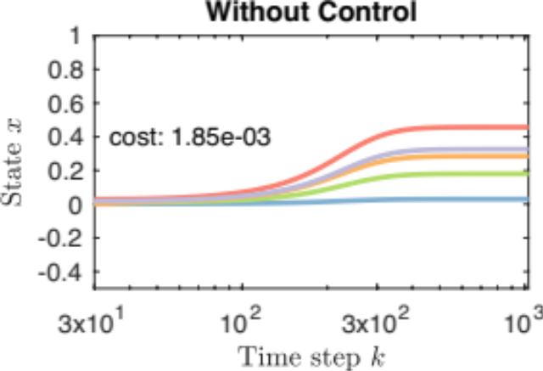
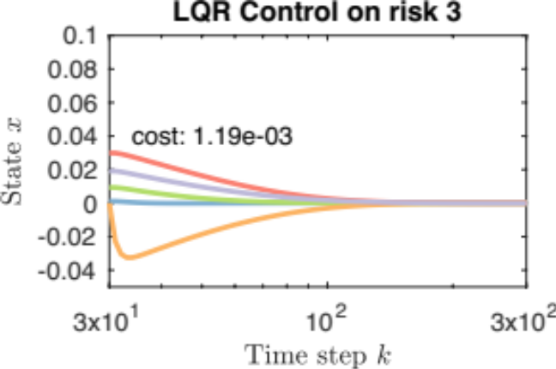
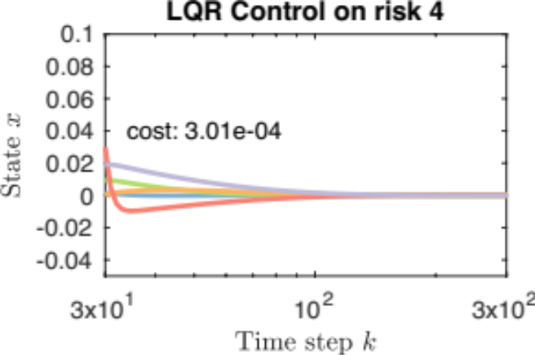
Proactive control example
Reactive
Proactive
Proactive
Proactive

Slide 41
Reactive vs Proactive
Prevention is better than Governance in terms of cost.
Reactive
Proactive
Notes:
Cost in proactive phase is by orders of magnitude less than that in reactive

Slide 42
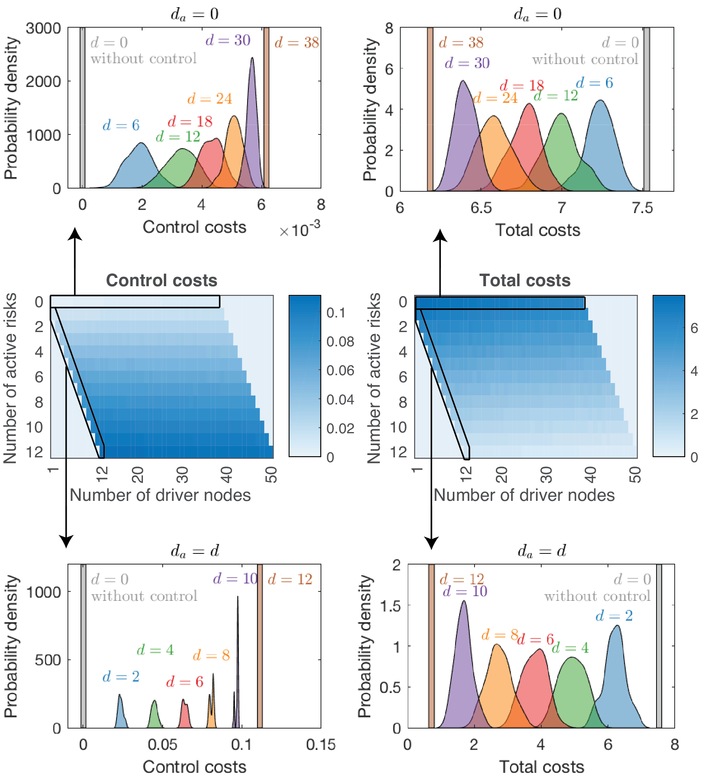
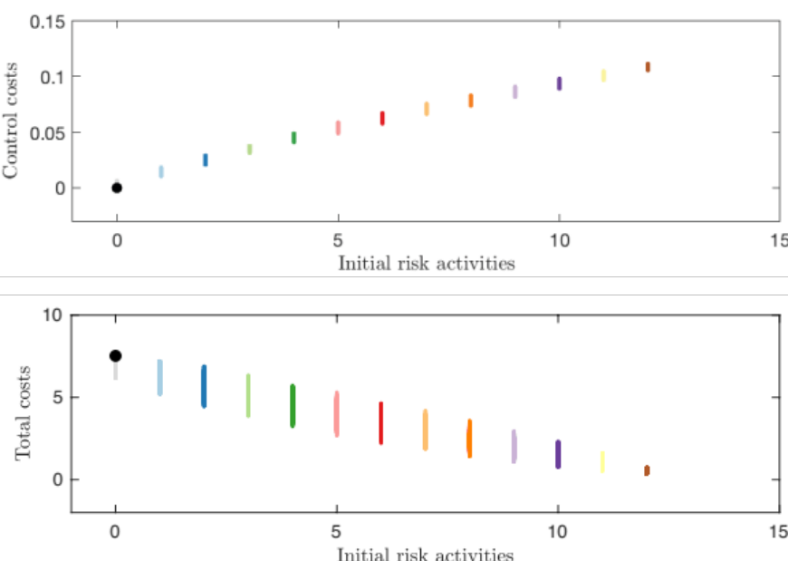
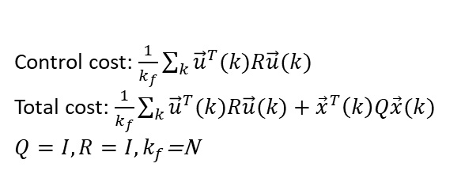
Reactive phase
Control cost: $\frac{1}{k_{f}}\sum_{k}{{\vec{u}}^{T}(k)R\vec{u}(k)}$
Total cost: $\frac{1}{k_{f}}\sum_{k}{{\vec{u}}^{T}(k)R\vec{u}(k)+{\vec{x}}^{T}\left(k\right)Q\vec{x}(k)}$
$Q=I, R=I,k_{f}$=N

Slide 43
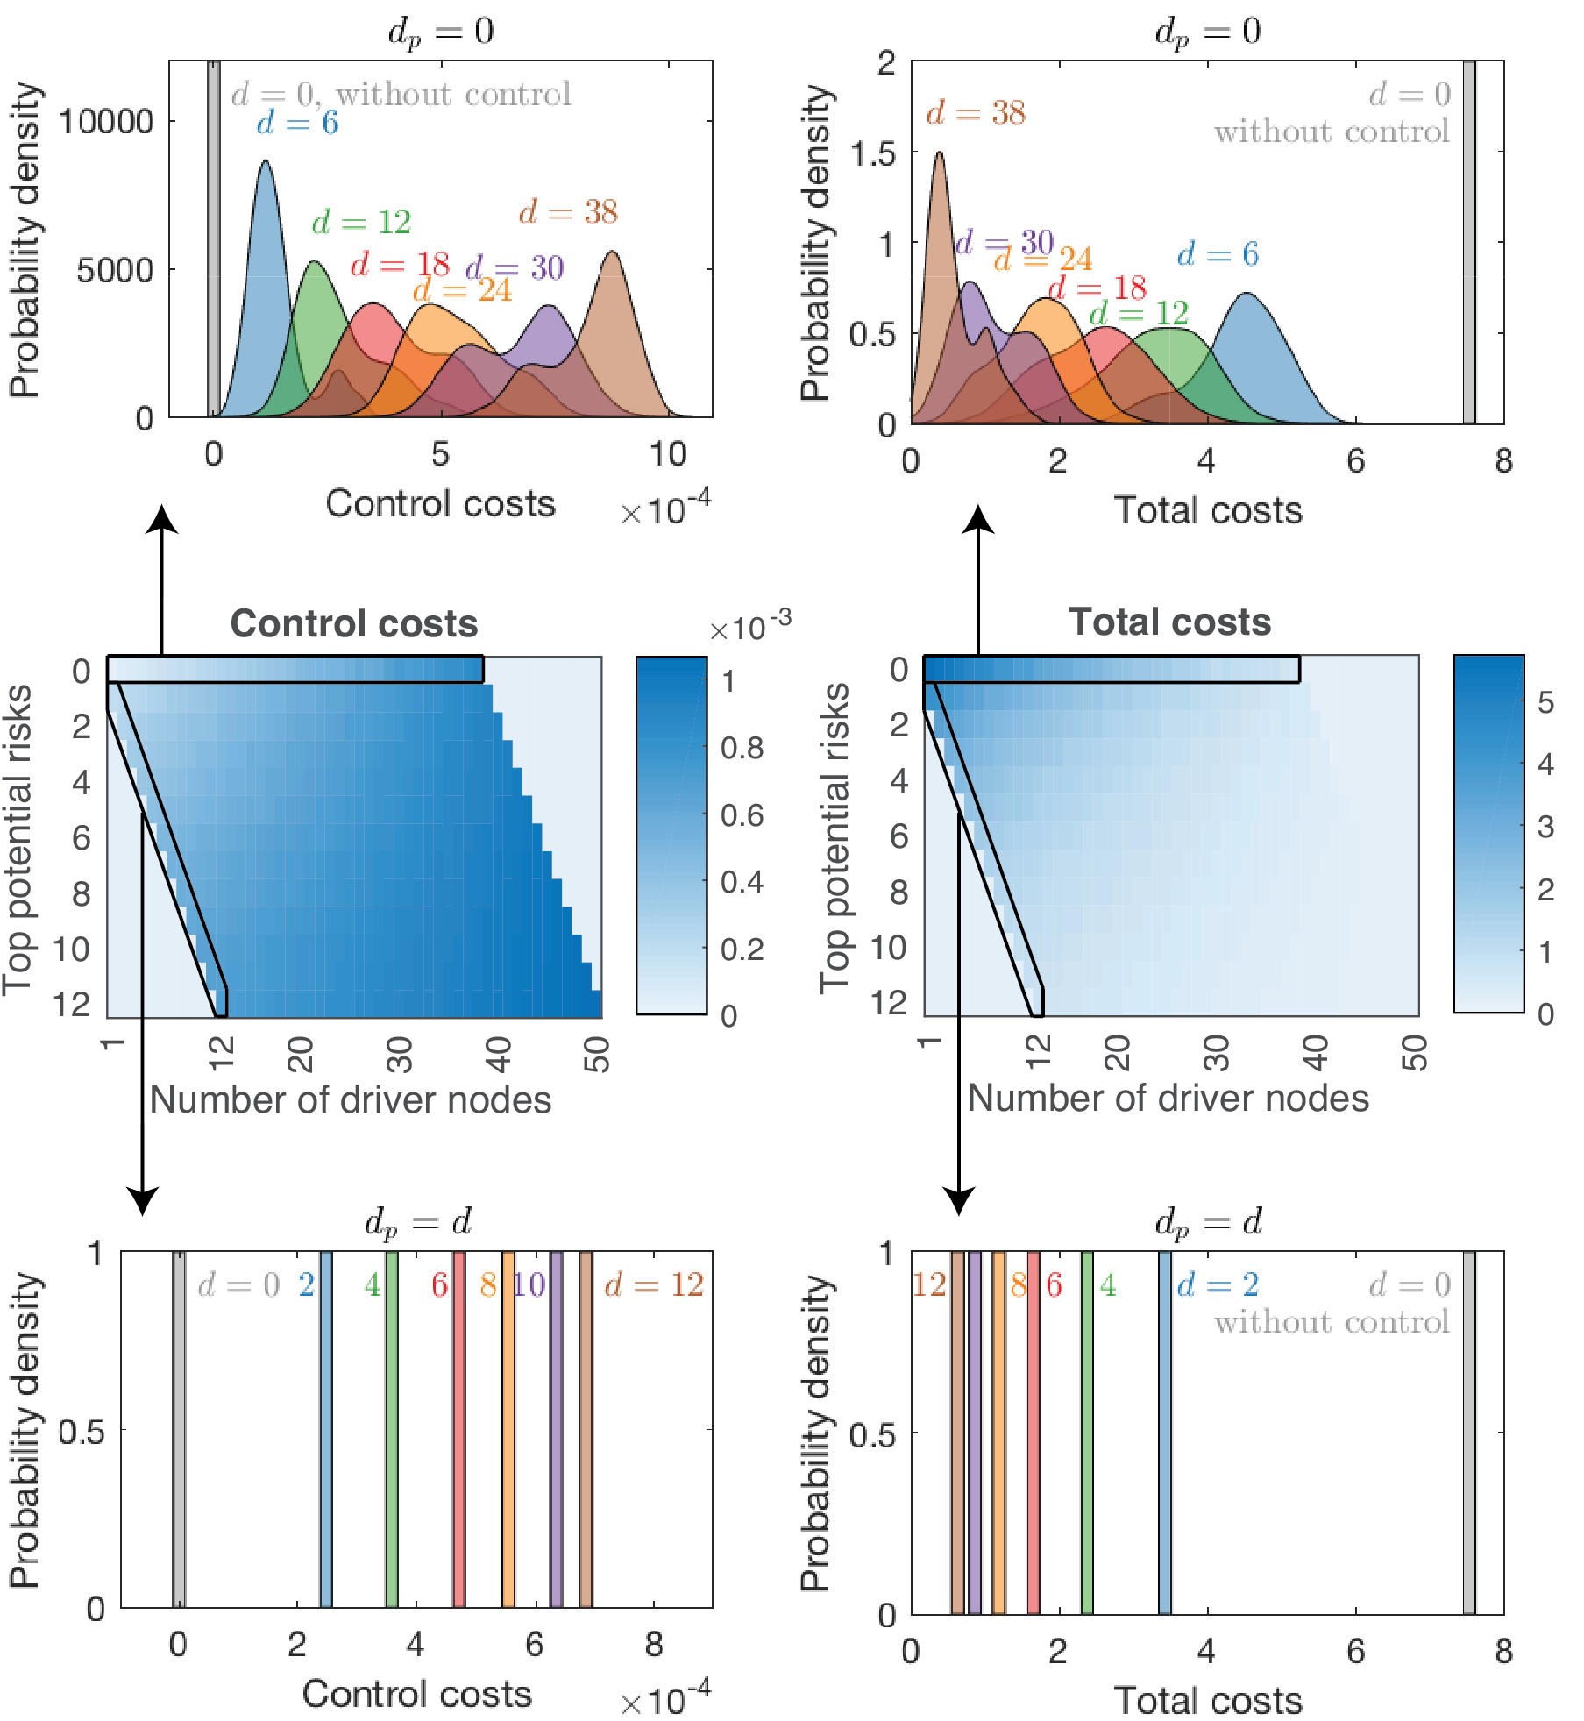
Proactive phase

Slide 44
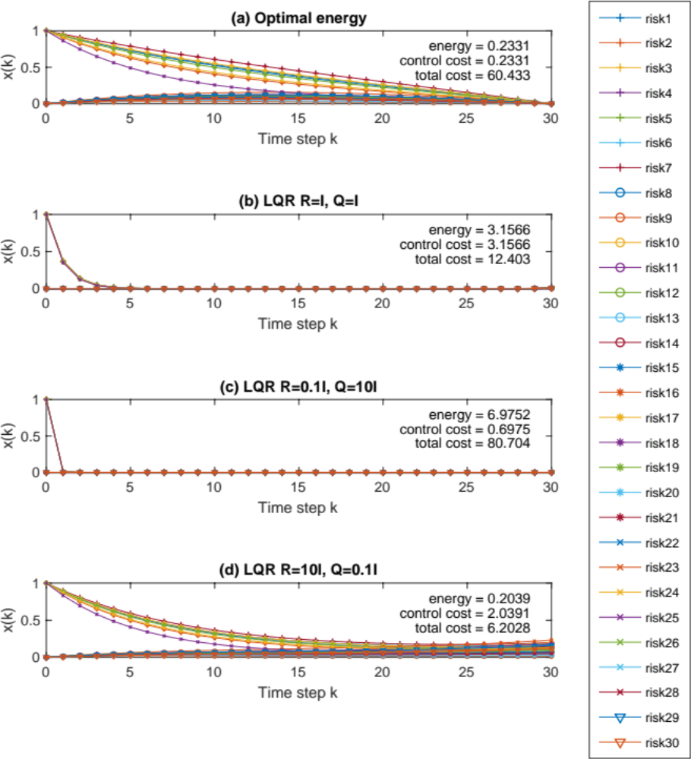
Optimize functions
Low cost of intermediate states

Slide 45
Optimize functions
Low cost of intermediate states
Low cost of control inputs

Slide 46
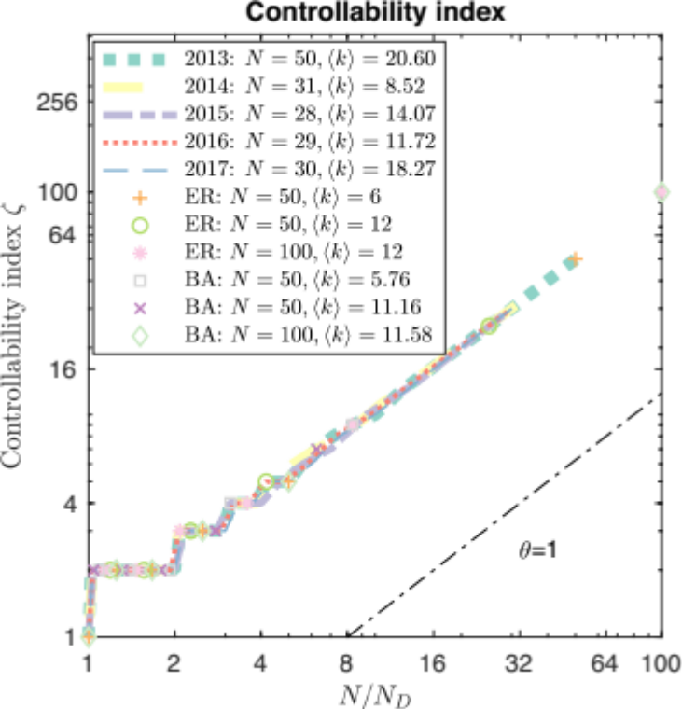
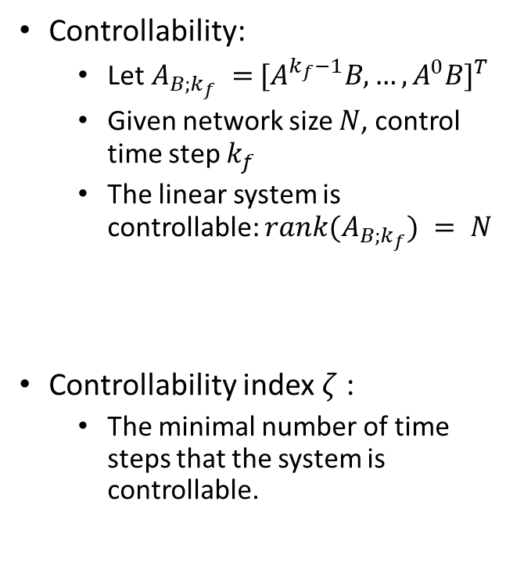

Controllability and controllability index
$$ζ=N/N_{D}$$
Controllability:
  Let $A_{B;k_{f}} ={ [A^{k_{f}−1}B,…,A^{0}B]}^{T}$
  Given network size $N$, control time step $k_{f}$
  The linear system is controllable: ${rank(A}_{B;k_{f}}) = N$
Controllability index $ζ$ :
  The minimal number of time steps that the system is controllable.

Slide 47




Log-Energy
Log-Energy $∝N/N_{D}$

Slide 48




Nonnegative Control
In CARP model with optimal energy control, the risk network is nonnegative controllable when $N_{D}=N$

Slide 49

Linear vs Nonlinear
Negative intermediate states
Nonnegative intermediate states

Slide 50

Optimal energy
Notes:
We test the experiments on both discrete and continuous system. There is around 1% difference of energy between the discrete and continuous model. The linear system is simpler and faster than nonlinear system, but require around one fifth extra energy.

Slide 51

Contributions:
Formally defined optimal control in the risk networks:
$$x\left(k+1\right)=F\left[x\left(k\right)\right]+G\left[x\left(k\right),E\right]+BU$$
Established a function of controllability index and corresponding optimal energy:
  Controllability index $ζ=N/N_{D}$
  Upper bound of optimal energy ${\hat{J}}_{ε}=e^{10N/N_{D}}$
Established condition for nonnegative optimal control: $N=N_{D}$
Quantitively analyzed the tradeoffs between control and state costs in Reactive and Proactive phases:
  Reactive: cost is almost linearly related to the controlled number of active risks
  Proactive: cost is proportional to the potential risk activities
  Prevention is better than Governance: the cost in the proactive phase is much smaller than that in the reactive phase

Slide 52

Contributions:
Provided an universal methodology of applying the LQR control in real world networked systems:
  Built a flight-delay network with five million flights record in 2015.
  Built a delay cost matrix $Q$ and aircraft cost matrix $R$ according to official statistic data
Provided significant results on flights control:
  LQR control saves around 90% time for the customer and 70% cost for the society on average.
  In over 5000 unique flights, almost every single one benefits from the LQR control.
Provided significant results on airports control:
  The small airport in the inland area benefits more than large international one in the coastal area
  In over 300 airports, almost every single one benefits from the LQR control.
Discovered that the airline ranking by simulated steady states in the CARP model are highly (above 0.8) correlated with Airline Quality Ranking.
Submitted to:
  X. Niu, C. Jiang, J. Gao, G. Korniss, and B. K. Szymanski. Data-driven control of networked risks with minimal cost. Nature Communications, 2019

Slide 53
Questions?

